Slide 1

RUNGTA COLLEGE OF DENTAL SCIENCES & RESEARCH
TITLE OF THE TOPIC: COMPLEXAMALGAM RESTORATION
DEPARTMENT OF CONSERVATIVE DENTISTRY AND ENDODONTICS

Slide 2
Specific learning Objectives
At the end of this presentation the learner is expected to know ;
Core areas* | Domain ** | Category #
NUMBER OF PIN SELF SHEARING PIN | COGNITIVE | MUST NOW
TWO IN ONE PIN | PSYCHOMOTOR | NICE TO KNOW
PIN HOLE PREPARATION | AFFECTIVE | DESIRE TO KNOW

Slide 3
CONTENTS
Introduction
Indications and contraindications
Factors to be considered.
Advantages and disadvantages
Pin retained amalgam restorations
Tooth preparation for pin retained amalgam restorations
Retentive pins
Mechanical aspect of pin retained restoration

Slide 4
THE THREAD MATE SYSTEM (TMS)
TMS (Coltene/ Whaledent Inc., Mahwah, NJ) is the most widely used self-threading pin because of its
(1) versatility
(2) wide range of pin sizes
(3) color-coding system
(4) greater retentiveness and
(5) gold-plated surface ﬁnish, which may eliminate the possibility of corrosion
Factors which determine selection of the appropriate size of pins are the amount of dentin available to safely receive the pin and the amount of retention desirable

Slide 5
PIN SIZE
Usually four sizes of pins are available, each with a corresponding colour-coded drill.
REGULAR | MINIM | MINIKIN | MINUTA
Largest diameter pins(0.78mm/.031”) Causes maximal stress Causes maximum dentinal crazing Rarely used | Next smaller diameter pins(0.61mm/0.024”) Lesser stress are created Lesser dentinal crazing Good retention used as a back up in cases where the pin hole for the Minikin was over prepared or the pin threads stripped the dentin during placement and the Minikin pin lacks retention | Diameter is lesser than minim pins (0.019”/0.48mm) Very less risk of dentinal crazing Good retention used in severely involved posterior teeth. MINIM AND MINIKIN ARE COMMONLY USED SIZES OF TMS SYSTEM | SMALLEST SIZE of pins (0.015”/0.38mm) They are too small to provide adequate retention Not widely used
Notes:
Two determining factors for selecting the
appropriate-sized pin are 1) the amount of dentin available to
safely receive the pin and 2) the amount of retention desired

Slide 6
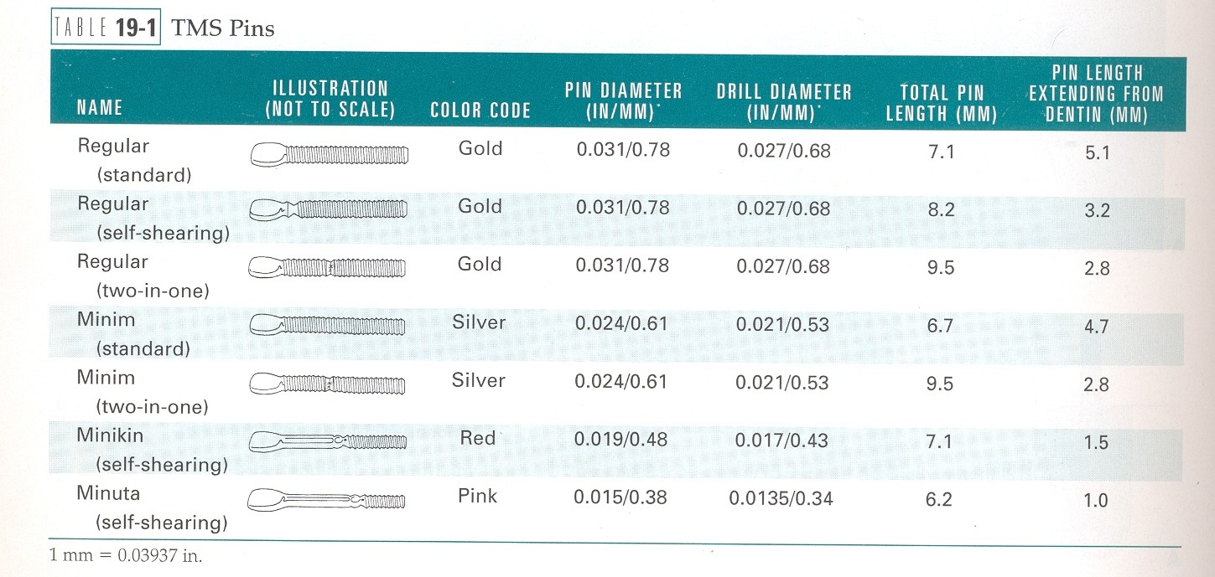
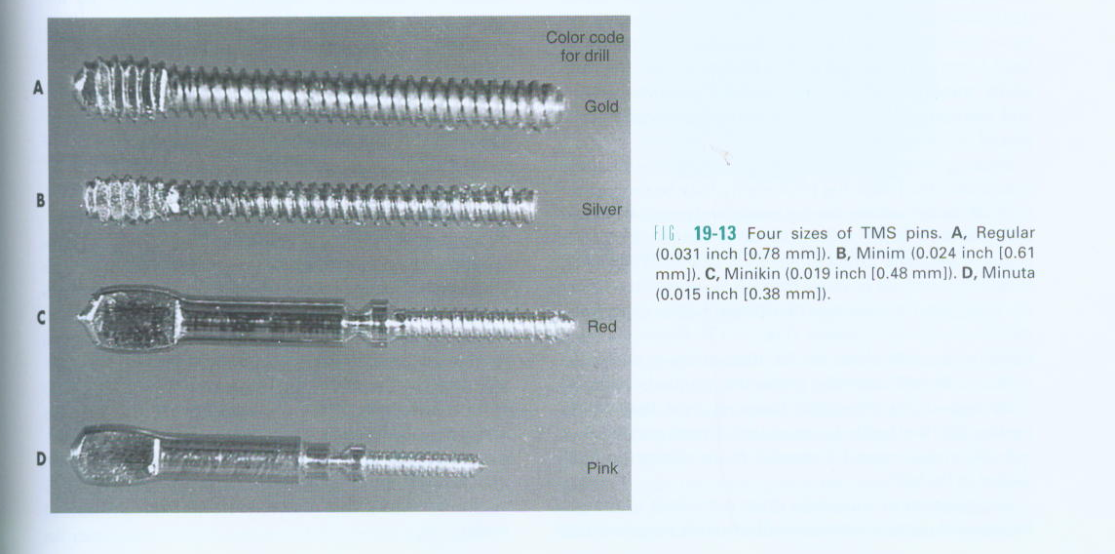
Four sizes of TMS pins.
A. Regular, B. Minim, C. Minikin, D. Minuta

Slide 7
FACTORS AFFECTING RETENTION OF THE PIN IN DENTIN AND AMALGAM
Type
Surface characteristics
Orientation,number and diameter
Extension into dentin and amalgam

Slide 8
TYPE.
Regarding retentiveness in the dentin, the self-threading pin is the most retentive, the frictionlocked pin is intermediate,and the cemented pin is the least retentive
SURFACE CHARACTERISTICS.
The number and depth of the elevations (serrations or threads) on the pin influence retention of the pin in the amalgam restoration.The shape of the self-threading pin gives it the greatest retention value.

Slide 9
ORIENTATION, NUMBER, AND DIAMETER
Placing pins in a nonparallel manner increases their retention.
Bending pins to improve retention in amalgam is not desirable because bends may interfere with adequate condensation of amalgam around the pin and decrease amalgam retention.
Bending also may weaken the pin and risk fracturing the dentin.
Pins should be bent only to provide for an adequate amount of amalgam (approximately 1mm) between the pin and the external surface of the ﬁnished restoration (on the tip of the pin and on its lateral surface).
Only the speciﬁc bending tool should be used to bend a pin, not other hand instruments.

Slide 10
In general, increasing the number of pins increases the retention in dentin and amalgam.
The beneﬁts of increasing the number of pins must be compared with the potential problems created.
As the number of pins increases,
the crazing of the dentin and the potential for fracture increase
(2) the amount of available dentin between the pins decreases
(3) the strength of the amalgam restoration decreases
Also generally, as the diameter of the pin increases,the retention in dentin and amalgam increases.

Slide 11
EXTENSION INTO DENTIN AND AMALGAM
For self threading pins, retention is not increased signiﬁcantly when the depth of the pin into dentin exceeds 2mm.
A laboratory study showed that a 0.024-inch (0.61-mm) self-threading pin fractures when removal from an embedment greater than 2mm is attempted
whereas removal of the 0.031-inch (0.78-mm) self-threading pin results in fracture of the dentin.

Slide 12
Likewise, when the length of a 0.024-inch (0.61-mm) self-threading pin extends into the amalgam more than 2mm and removal is attempted,the pin fractures
Pin extension into dentin and amalgam greater than 2mm is unnecessary for pin retention and is contraindicated to preserve the strength of the dentin and the amalgam.

Slide 13
PIN PLACEMENT FACTORS AND TECHNIQUES
pin size
pin design
number of pins
pin location
pin hole preparation
pin insertion

Slide 14
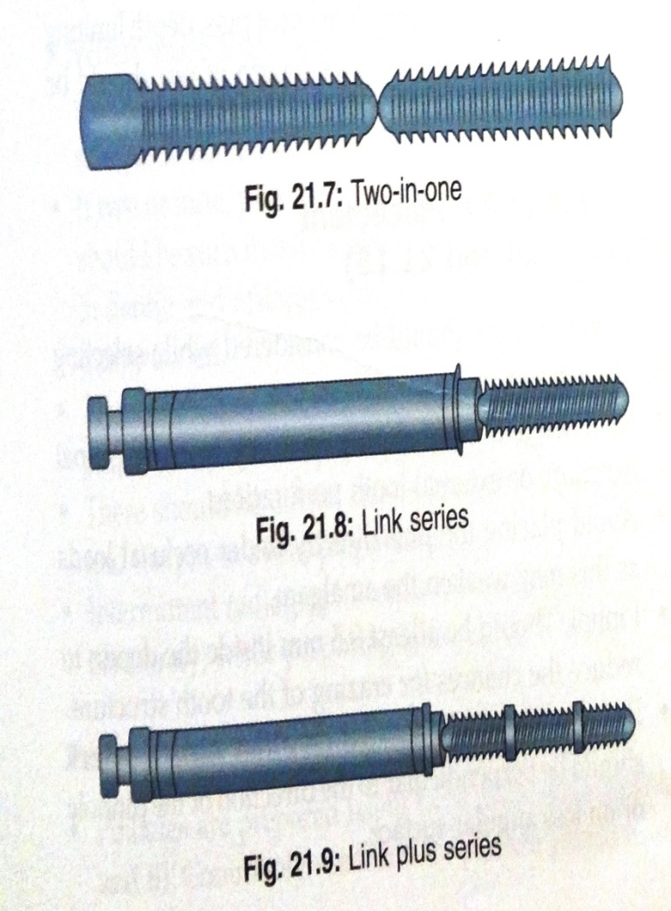
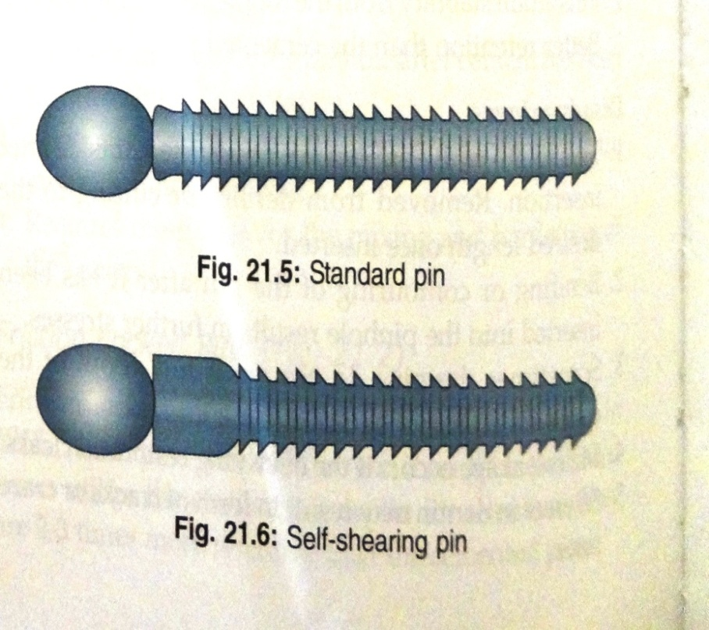
PIN DESIGNS
Standard pin
Self shearing pin
Two in one
Link series
Link plus series

Slide 15
THE STANDARD PIN
The standard pin is approximately 7mm long with a flattened head to engage the hand wrench or the appropriate handpiece chuck and is threaded to place until it reaches the bottom of the pinhole as judged by tactile sense.
One advantage of the standard design pin is that it can be reversed one quarter to one half turn after insertion to full depth to reduce stress created at the apical end of the pinhole

Slide 16
SELF SHEARING PINS
The self-shearing pin has a total length that varies according to the diameter of the pin
It also consists of a flattened head to engage the hand wrench or the appropriate handpiece chuck for threading into the pinhole.
When the pin approaches the bottom of the pinhole and begins to bind, the head of the pin shears of leaving a length of pin extending from dentin.

Slide 17
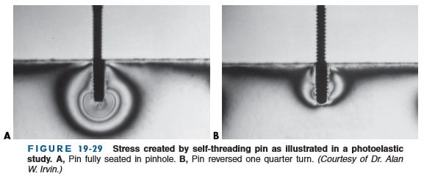

Slide 18
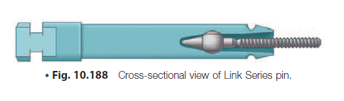
LINK SERIES PIN
Link Series pin is free floating in a plastic sleeve, which allows self-alignment as it is threaded into the pinhole
When the pin reaches the bottom of the hole, the top portion of pin shears of, leaving a length of pin extending from dentin.the plastic sleeve is then discarded.
The Minuta, Minikin, Minim, and Regular pins are available in the Link Series.
Link Series pins are recommended because of their versatility, self-aligning ability, and retentiveness

Slide 19
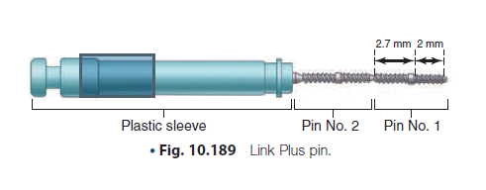
LINK PLUS SELF-THREADING PINS
Link Plus self-threading pins are also self-shearing and are available as single and two-in-one pins contained in color-coded plastic sleeves
This design has a sharper thread, a shoulder stop at 2 mm, and a tapered tip to it the bottom of the pinhole more readily as prepared by the twist drill.
It also provides a 2.7-mm length of pin to extend out of dentin, which usually needs to be shortened with the use of a handpiece bur.
Kelsey et al. reported that the two-in-one Link Plus first and second pins seat completely into the pinhole before shearing.

Slide 20
TWO IN ONE PIN
Two pins in one, with each one being shorter than the standard pin. The two-in-one pin is approximately 9.5 mm in length and has a lattened head to aid in its insertion.
When the pin reaches the bottom of the pinhole, it shears approximately in half, leaving a length of pin extending from dentin with the other half remaining in the hand wrench or the handpiece chuck.
This second pin may be positioned in another pinhole and threaded to place in the same manner as the standard

Slide 21
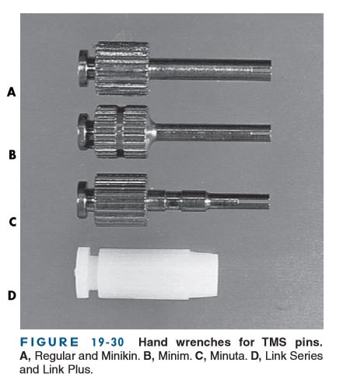
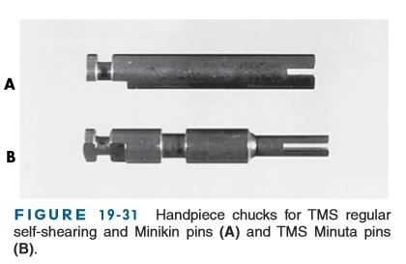

Slide 22
Selection of pin design depend on size of pin used, amount of interach space available and operator preference.
Link series pin →preferred ( versatility,self aligning ability and retentiveness)
Two in one pin and self shearing pin may fail to reach bottom of the pin hole
93%of link series and link plus two in one pins can extend to optimal depth of 2mm.

Slide 23
NUMBER OF PINS
Factors to be considered
  the amount of missing tooth structure
  the amount of dentin available to safely receive the pins
  the amount of retention required
  the size of the pins
one pin per missing axial line angle should be used

Slide 24
the retention of the restoration increases as the number of pins increases, an excessive number of pins may fracture the tooth and significantly weaken the amalgam restoration
The fewest pins possible should be used to achieve the desired retention for a given restoration.
When only 2 to 3mm of the occlusogingival height of a cusp has been removed,no pin is required because enough tooth structure remains to use conventional retention features

Slide 25
PRINCIPLES OF PIN LOCATION
Factors that aid in determining the pinhole locations include
knowledge of normal pulp anatomy and external tooth contours
a current radiograph of the tooth
a periodontal probe
the patient’s age.

Slide 26
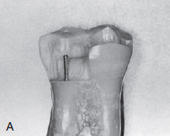
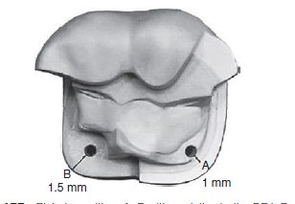
Occlusal clearance should be sufficient to provide 2 mm of amalgam over the pin
placement of pins ideal in areas where the greatest bulk of amalgam will occur so as to compensate (through the reinforcing tendency of the amalgam restoration) for the weakening effect of the pins on the tooth structure.
The pinhole should be positioned no closer than 0.5 to 1 mm to the DEJ or no closer than 1 to 1.5 mm to the external surface of the tooth,whichever distance is greater

Slide 27
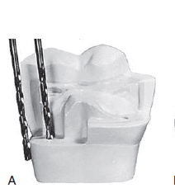
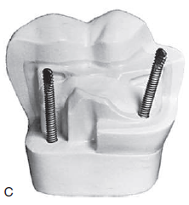
the pinhole should be parallel to the adjacent external surface of the tooth
minimum 0.5-mm clearance around the circumference of the pin for adequate condensation of amalgam
Pinholes should be prepared on a flat surface that is perpendicular to the proposed direction of the pinhole.
The minimal inter pin distance is 3 mm for the Minikin pin and 5 mm for the Minim pin.
If Three or more pin holes are placed they should be placed at different anatomical plane

Slide 28
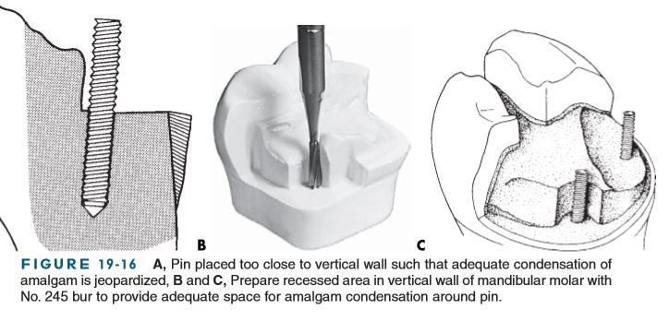

Slide 29
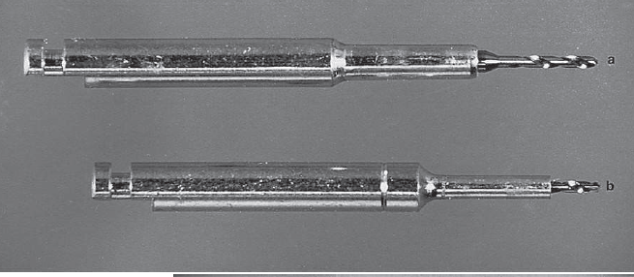
Pin hole preparation
the KODEX drill (a twist drill provided in the TMS system) should be used for preparing pinholes
the optimal depth of the pinhole into the dentin is 2 mm (only 1.5 mm for the Minikin pin), a depth-limiting drill should be used to prepare the hole
The standard twist drill has blades that are 4 to 5 mm in length, which would allow preparation of a pinhole with an efective depth. Creation of a flat area and use of the depth-limiting drill provide for a more predictable outcome and are recommended.
Notes:
Standered and depth limiting , omni depth gauge

Slide 30
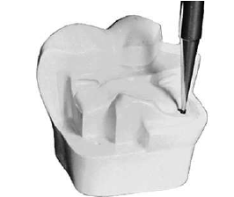
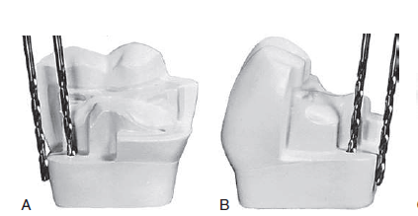
the technique of creating a properly aligned pinhole is as follows:
A pilot hole (dimple) is placed in the horizontal dentin surface to receive the pin
The correct size Twist drill (based on the pin size) is placed in a latch-type contra-angle handpiece
The twist drill is placed in the gingival crevice beside the location for the pinhole and positioned such that it lies flat against the external surface of the tooth

Slide 31
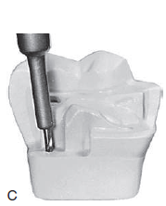
Without changing the angulation obtained from the gingival crevice position, the handpiece is moved occlusally and the drill placed in the previously prepared pilot hole

Slide 32
TAKE HOME MESSAGE
Because of its history, the complex amalgam restorations may be the most frequently placed complex restoration.
However due to the increasing benefits of composites, the many types of auxiliary retention forms available, and the variations of tooth preparations required for complex restorations, the operator should be familiar with all of these techniques, if he or she is to use these restorations on a regular basis.

Slide 33
QUESTIONS
WHAT IS TWO IN ONE PIN
PIN HOLE PREPARATION
LINK SERIES PIN

Slide 34
REFERENCES:
1. Sturdevant's Art and Science of Operative Dentistry - fourth Edition
2. Operative Dentistry - Modern theory and practice - First Edition- M.A. Marzouk
3. Text book of operative dentistry - Vimal K. Sikri
4.Fundamentals of Operative Dentistry- Summit JB- 2nd edition
5.Text book of operative dentistry → nisha carg,amit carg
6.Principles and Practice of Operative Dentistry-Gerald T. Charbeneau-Third edition.
7.Clinical operative dentistry-principles and practice→ramya Raghu,Raghu sreenivasan

Slide 35
THANK YOU

